Slide 1

Media Library Presentation
David GUNEY

Slide 2
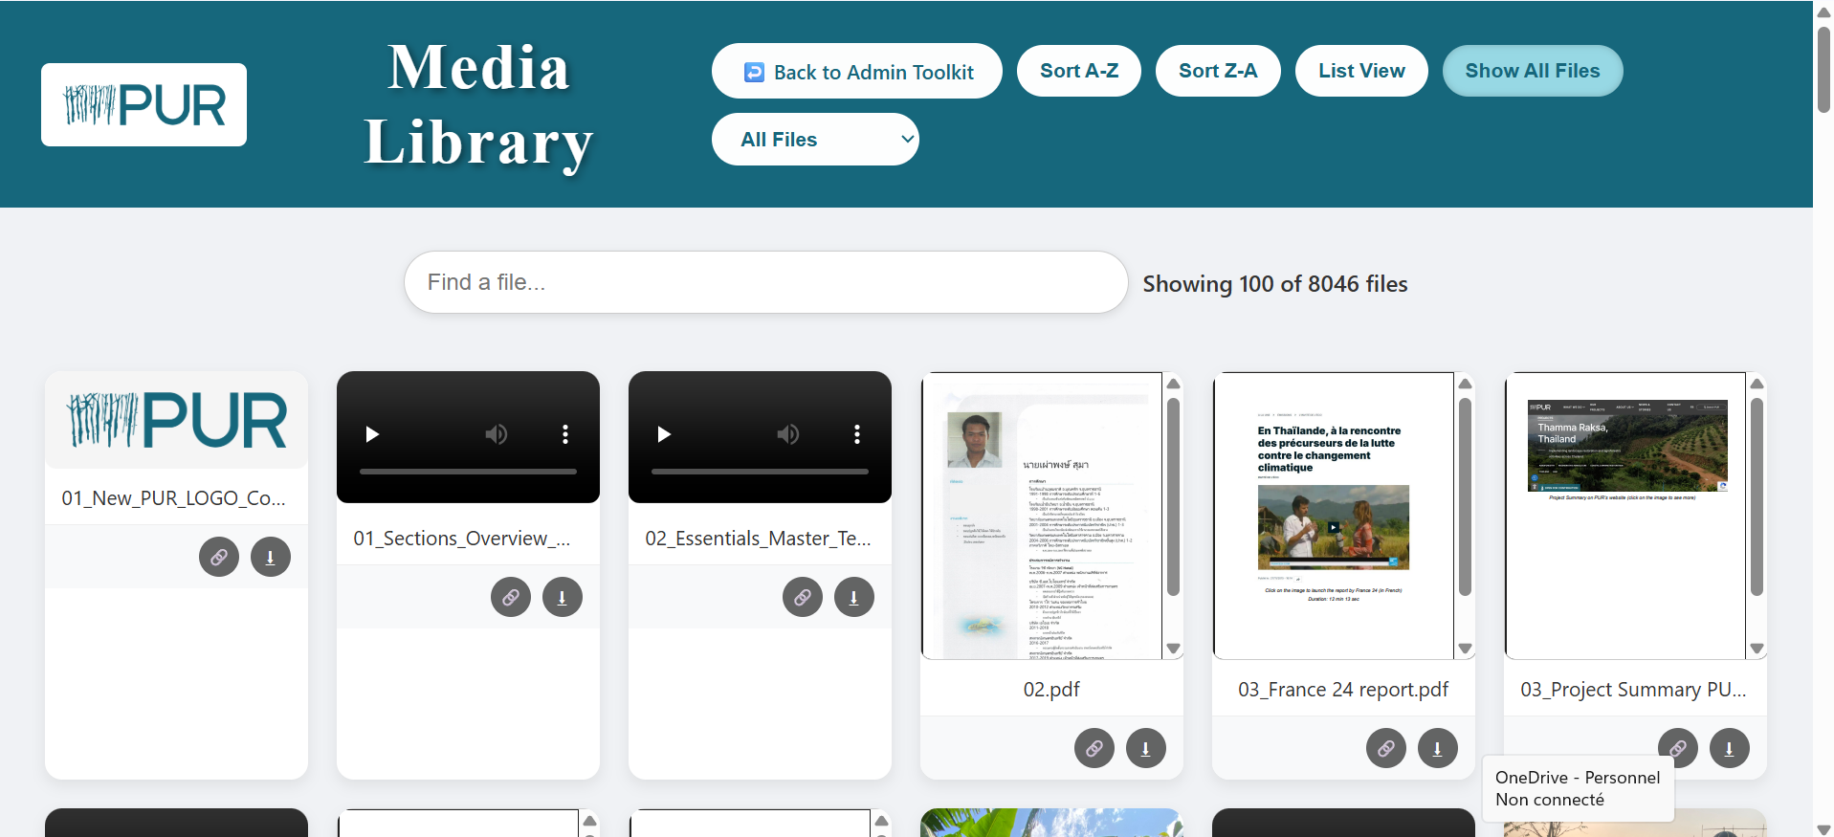
Media Library HomePage
When you arrive on the page, you are directly accessed to the site.
You can find all kinds of audio, video or image files there.
The site is by default with a pagination of 100 files per page to improve performance.

Slide 3
Media Library Button
The first button allows you to return to the admin toolkit on SharePoint.
The following two allow you to sort the files contained in the page in ascending or descending alphabetical order.

Slide 4
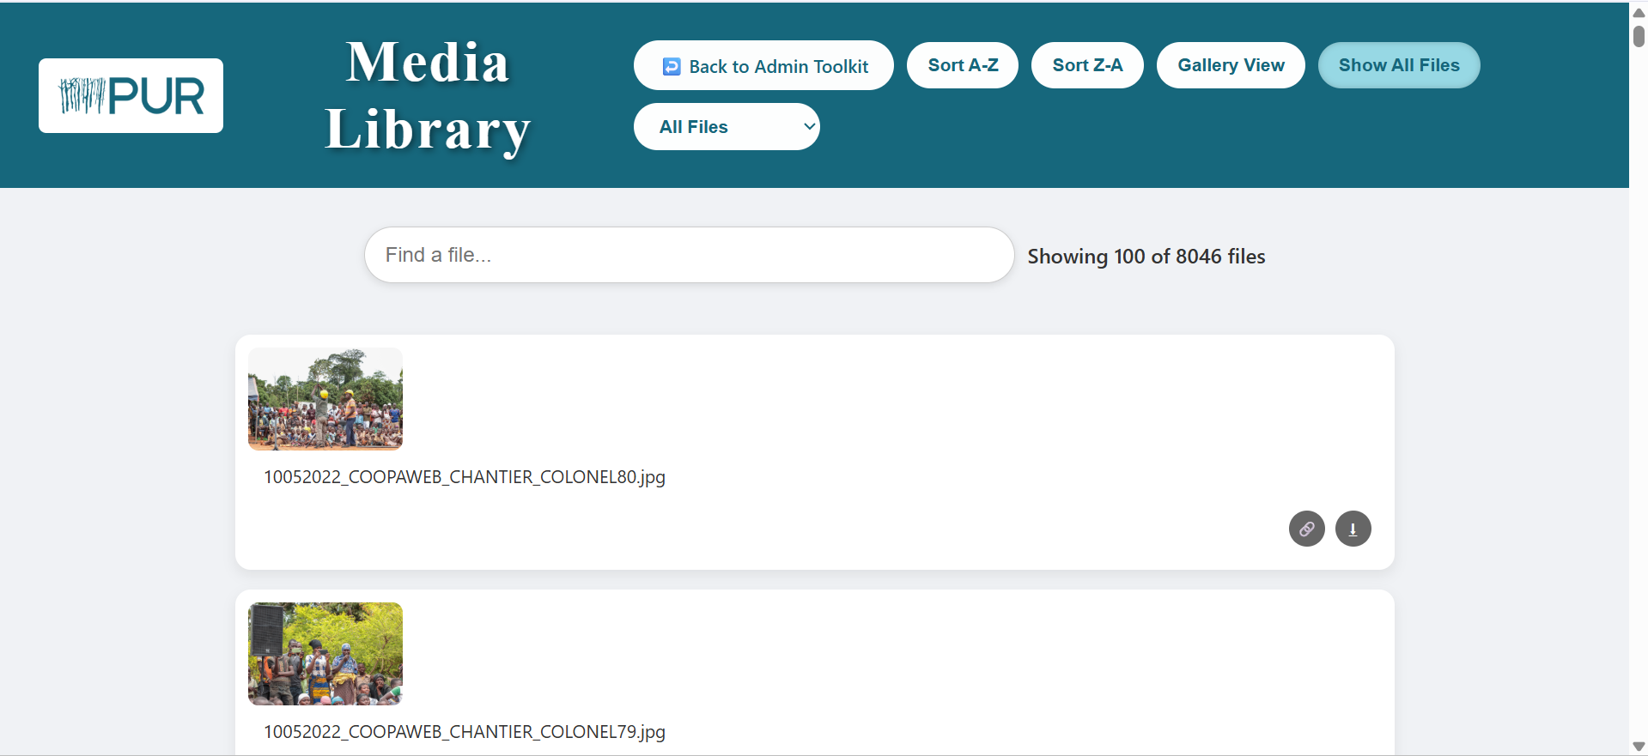
Media Library Button
The List View button allows you to see all files in a list format according to your preference.
You can press it again to return to the original format.

Slide 5
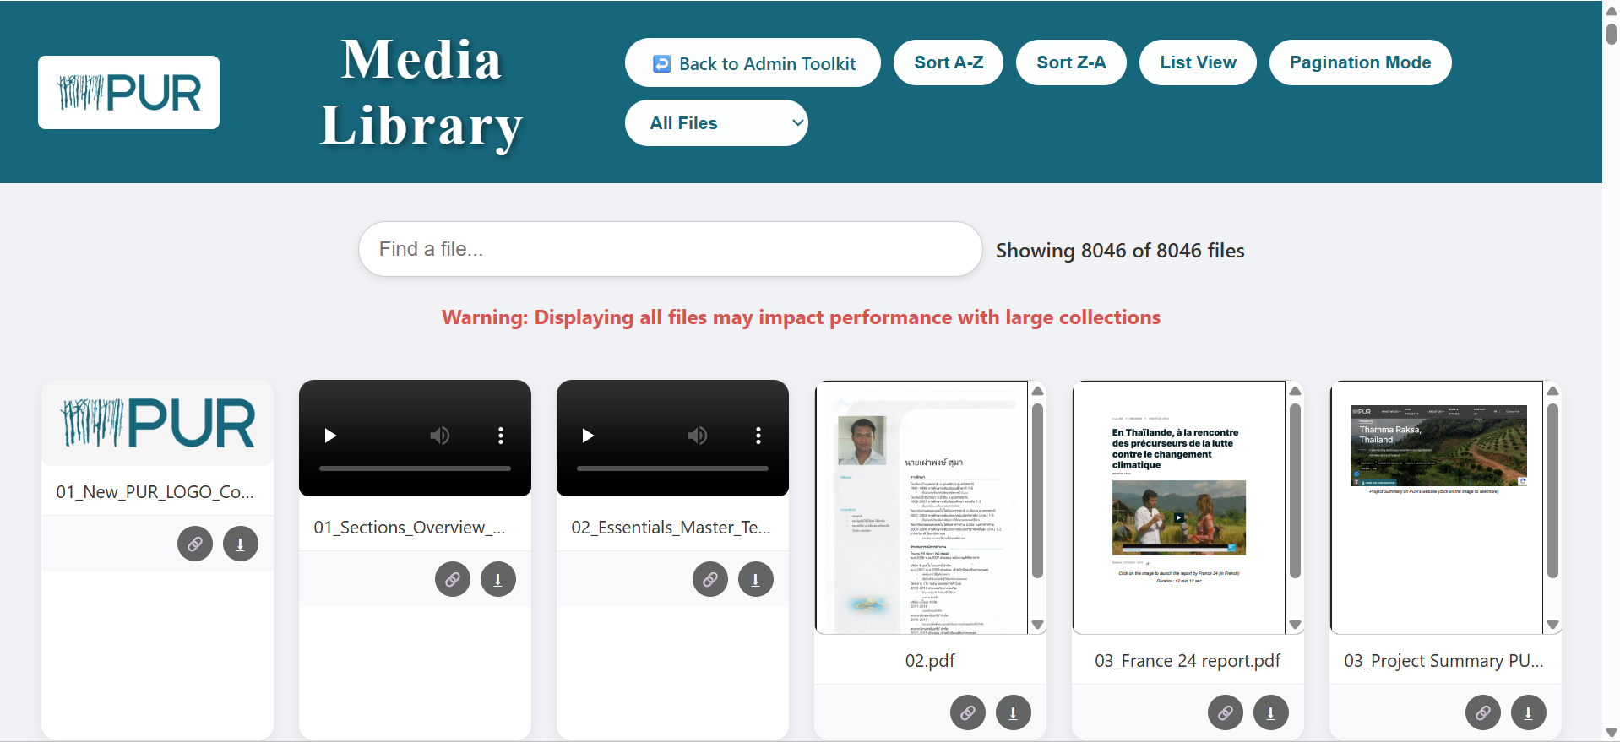
Media Library Button
This button allows you to access all the files contained in the site, but be careful, the site's performance may decrease.

Slide 6
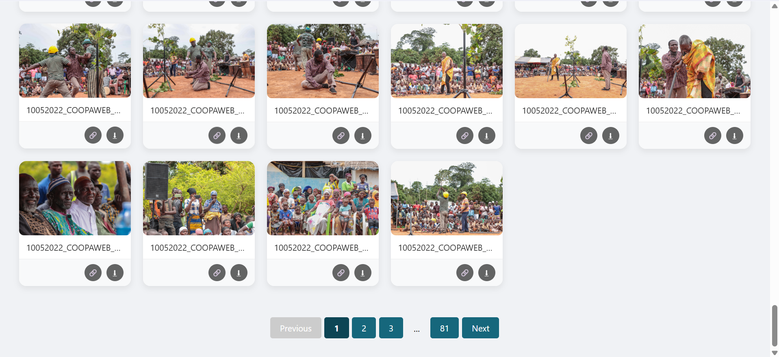
Media Library Button
At the bottom of the page you can find the pagination with the number of pages and you can scroll with the previous or next buttons depending on your choice.

Slide 7
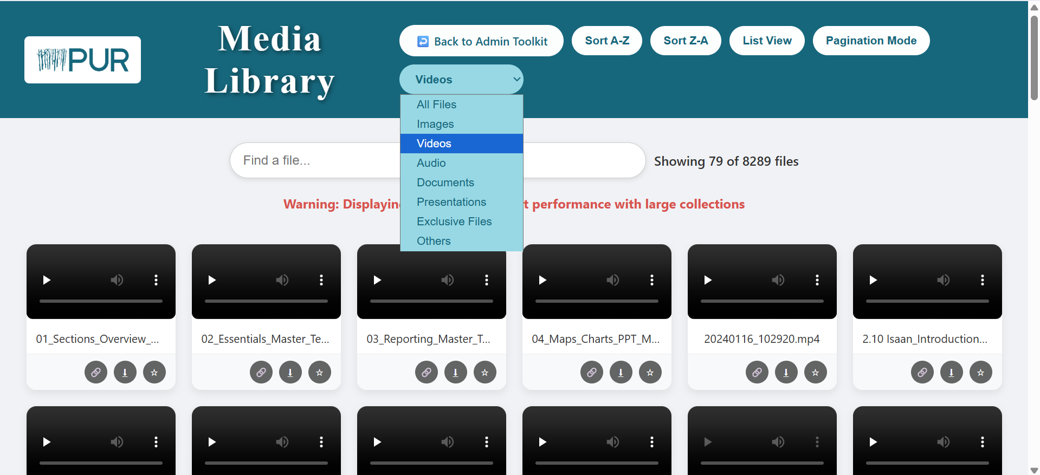
Media Library Button
This button allows you to sort according to the type of file you want, for example here we only want videos.
We also have buttons to download, copy the file link and mark a file as exclusive which allows them to be bookmarked to help the commercial team have the appropriate materials to share with their clients, which are exclusive to them.

Slide 8
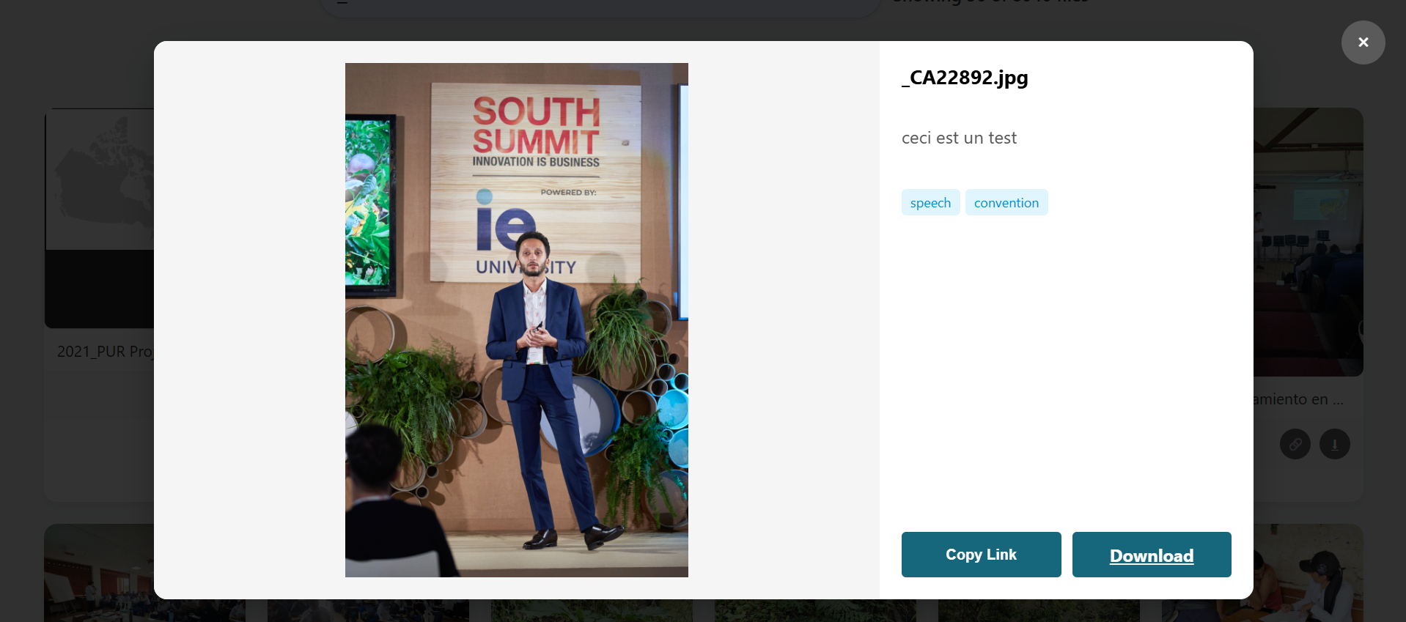
Media Library File
On each file on the site we have a preview of the file when possible but we can also click on a file to have a larger preview, with a description and tags when there are any.

Slide 9
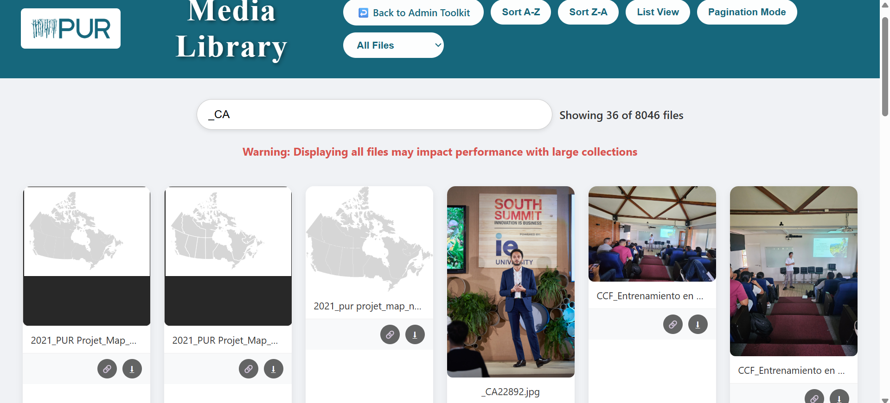
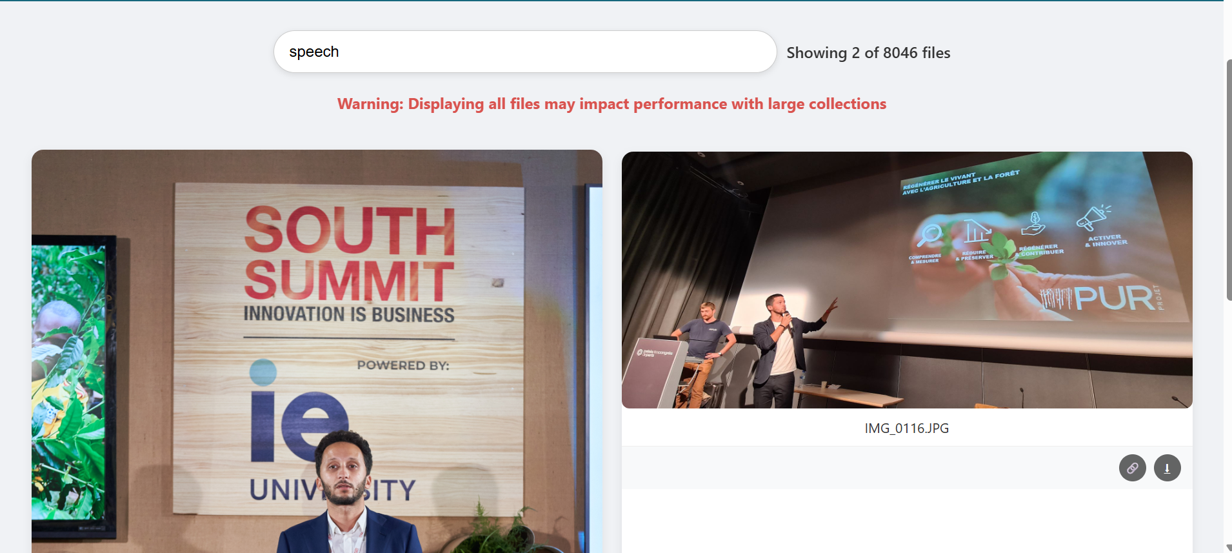
Media Library Research
You can search for files by their file name.
Or by the tags they have.

Slide 10
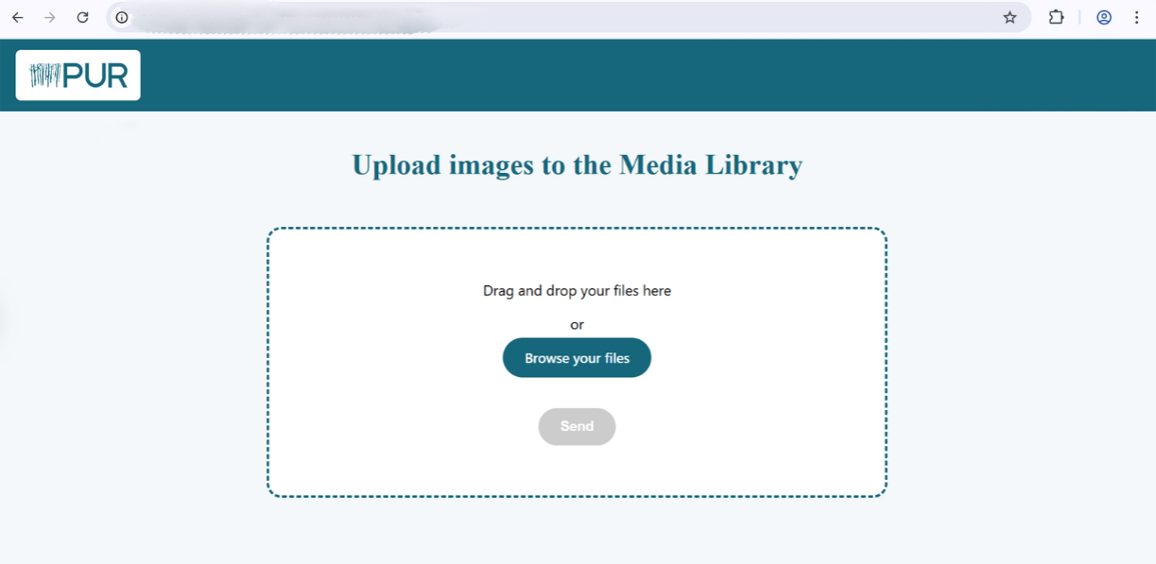
Media Library Upload
What you’re looking for ?
To upload a file, the page is only accessible via a link with a specific token dedicated to this page, without this token it is impossible to access it.
you just have to add after the url:
/upload?token=secretTokenForThoseWhoHaveTheRights

Slide 11
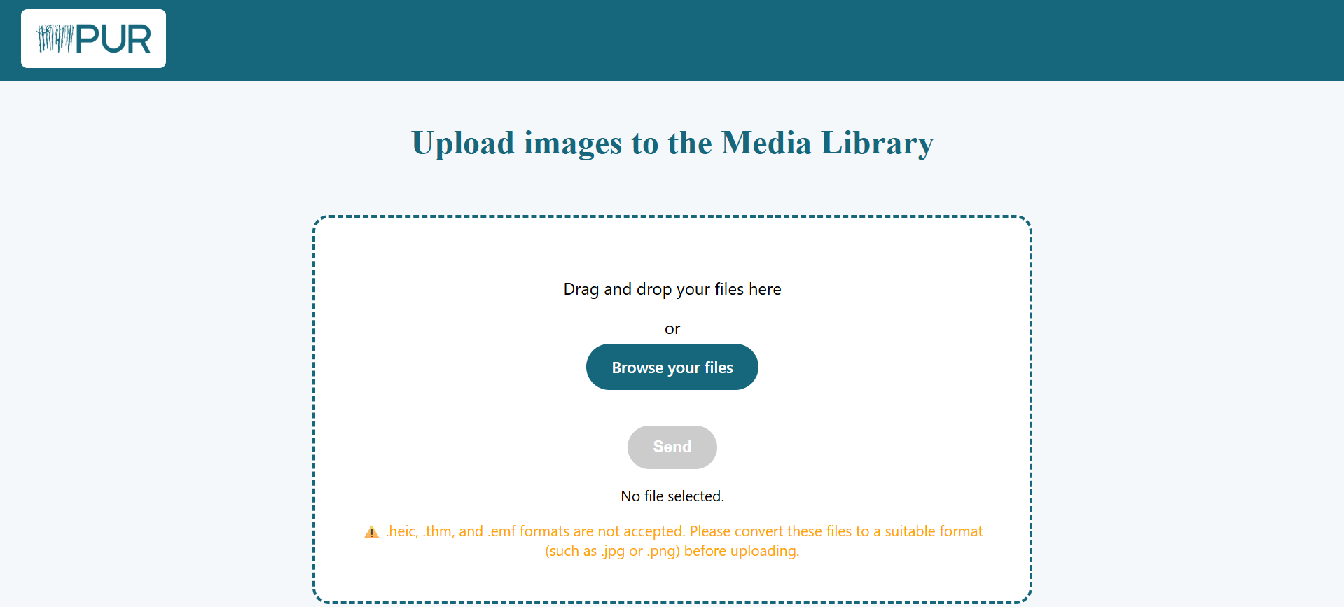
Media Library Upload
Some file extensions are not accepted because they cannot be displayed on a web page, the browser cannot display them, which is why you will be asked to convert them to a suitable format if the page refuses to upload them.

Slide 12
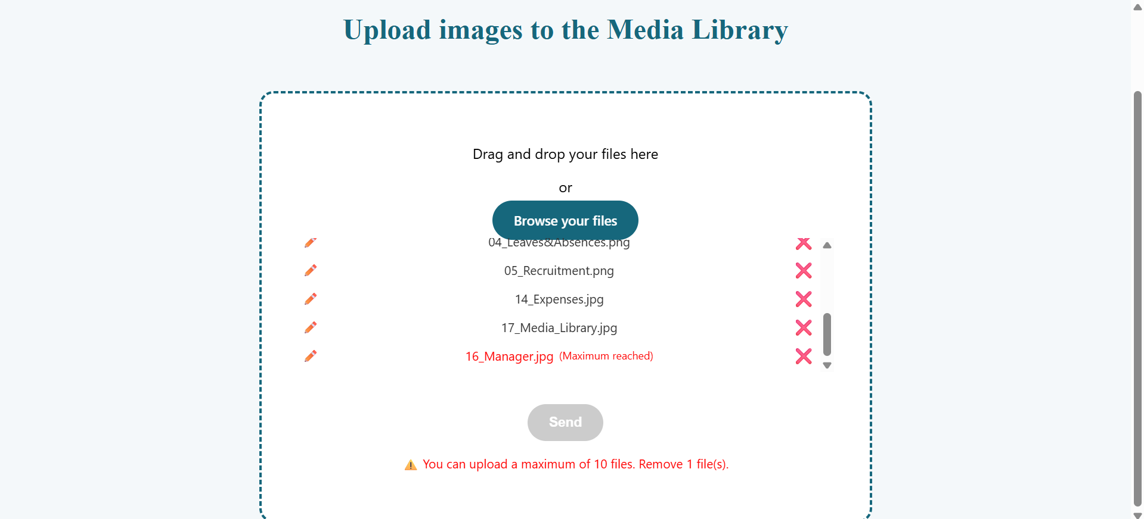
Media Library Upload
You can upload up to 10 files at once, beyond this number, the page will show you the files to delete for the upload to be done. You can also put a .zip there and it will unzip it to display all the files contained.
!!

Slide 13
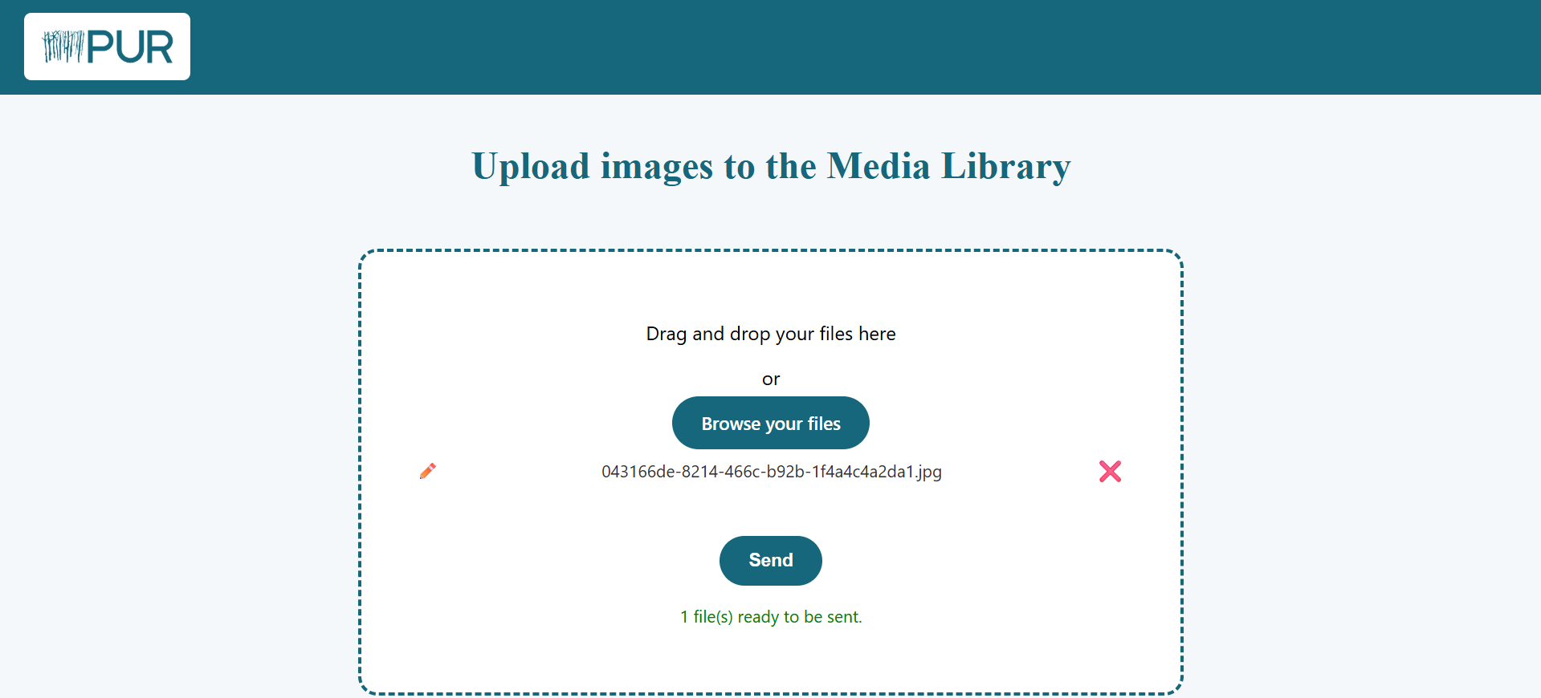
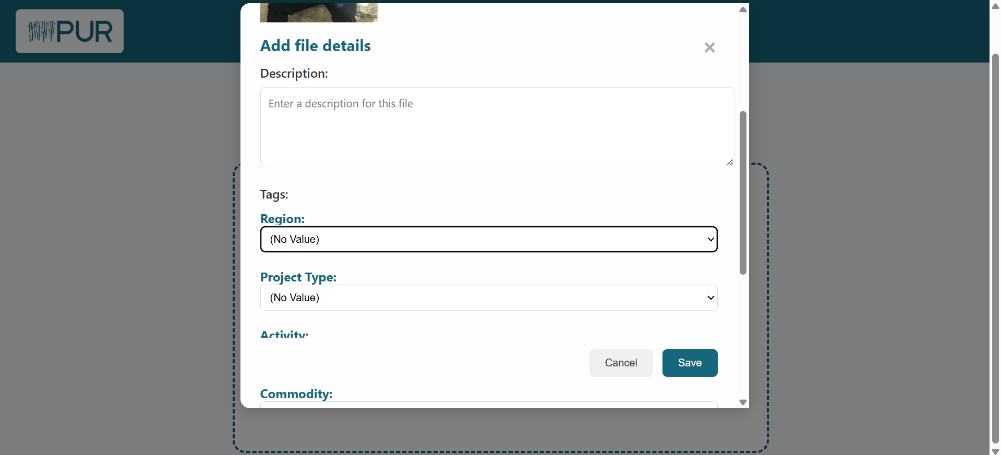
Media Library Upload
Once you have uploaded a file that is acceptable to the page, you can either delete it if you wish,
or click on the small icon to add a description and tags either already predefined or add your own tags yourself to give context to your image and make it easier to find using tags.
Then your file will be ready to be sent and the current date will be automatically displayed when previewing your file on the site !

Slide 14
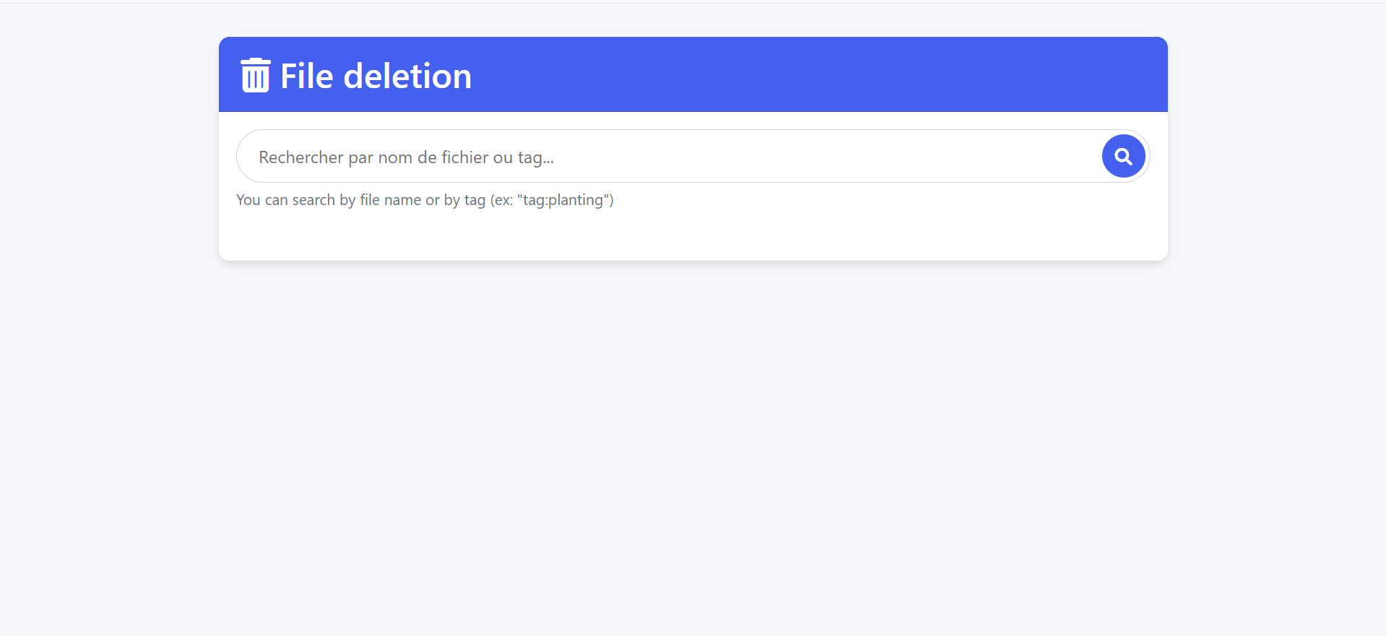
Media Library Delete
You can also delete a file if it's already on the site. To do this, simply go to the URL : /delete?token=secretTokenForThoseWhoHaveTheRights.
Just like on the upload page.
You can then search for the desired file by its name or by a specific tag by simply typing "tag:enterTheNameOfTheTag."

Slide 15
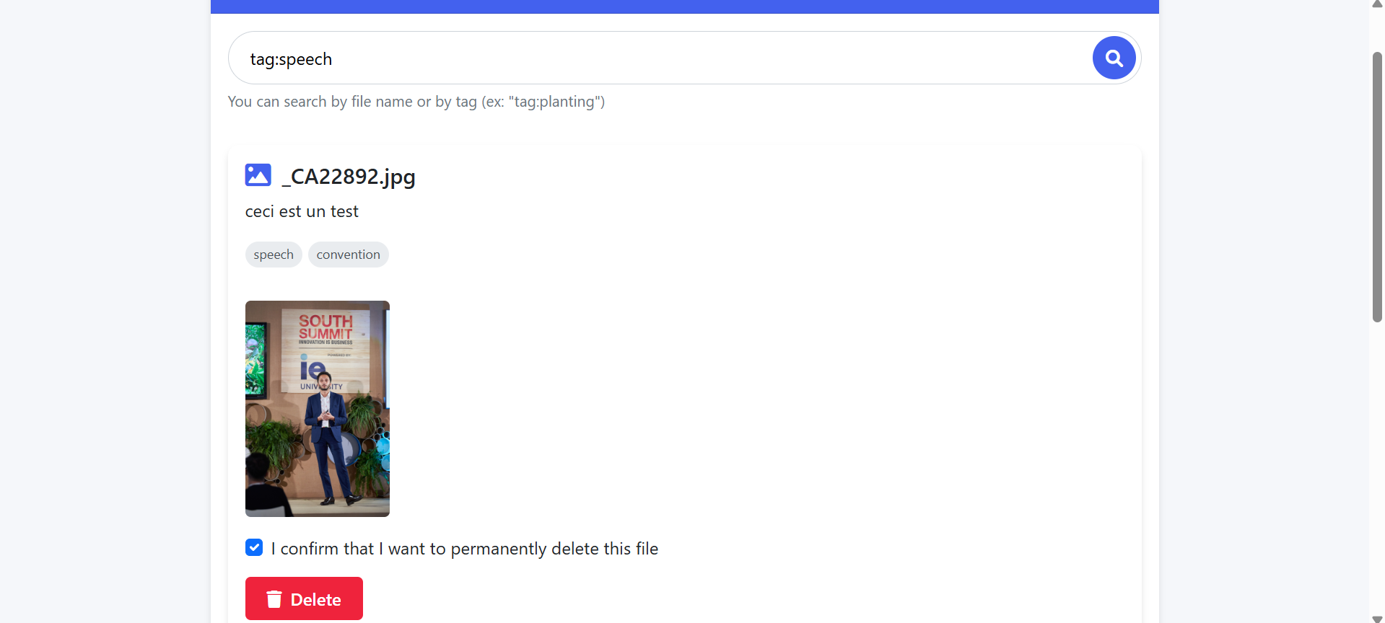
Media Library Delete
After finding the image you want to delete, just check the button that says you confirm what you are doing and press the delete button, a new confirmation message will appear and the image will be deleted from the site !

